Slide 1


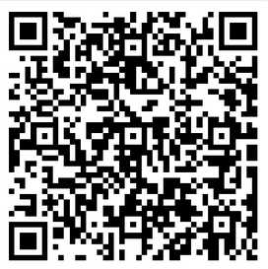
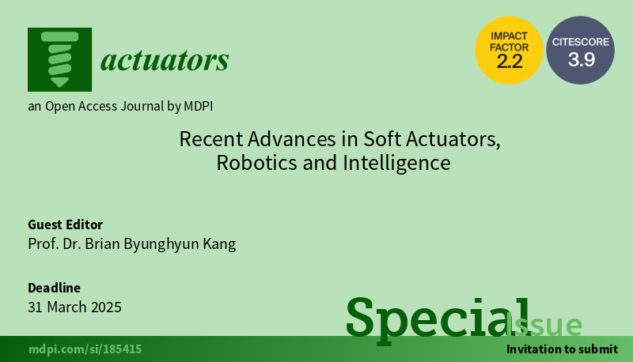
Special Issue: Recent Advances in Soft Actuators, Robotics and Intelligence
Contact us:
Prof. Dr. Brian Byunghyun Kang
brianbkang@sejong.ac.kr
Actuators Editorial Office actuators@mdpi.com
Deadline for manuscript submissions: 31 March 2025
https://www.mdpi.com/journal/actuators/special_issues/L21IU2ZFN9
Call for Paper
This Special Issue will focus on the latest advances in the field of soft technologies for robot realization. Here, we invite you to share your latest findings by submitting high-quality manuscripts that address the following challenges in the field:
Soft actuators and pliable mechanisms in robotics;
Artificial muscles;
Material and structural design of soft actuators;
Soft materials in soft actuators or robots;
…

